Slide 2
LifeGroups 101 Reach, Learn, Love, Multiply

Slide 3
LifeGroups’ Role in Mission Fulfillment
Our mission at Prestonwood is to glorify God by introducing Jesus Christ as Lord to as many people as possible and to develop them in Christian living using the most effective means to impact the world, making an eternal difference in this generation and generations to come.

Slide 4
Our LifeGroup Values
Reach – Reaching our community, the nation, the world, and every generation with the Gospel
Learn – Learning to grow in an authentic and visible faith
Love – Loving those around us with a biblically based devotion to Jesus
Multiply – Multiplying our influence and effectiveness by entrusting what God has done in our lives to others

Slide 5
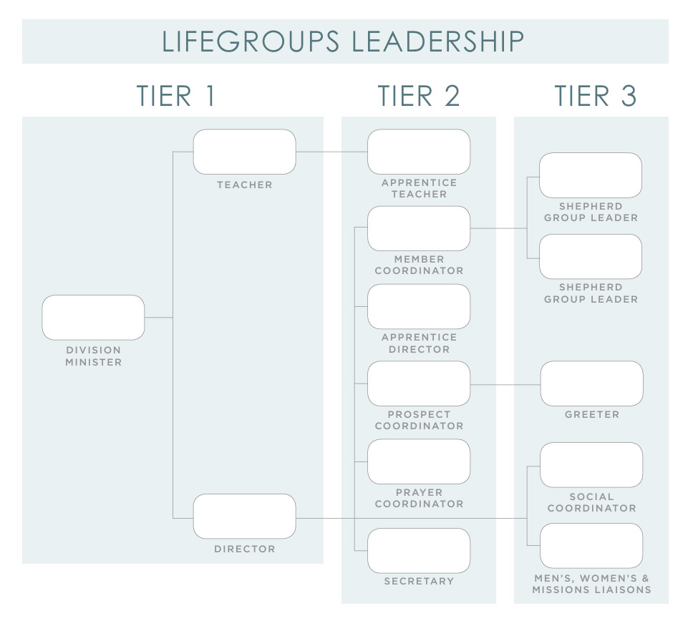

Slide 6
Director
Plans and administers the total work of the LifeGroup by recruiting leaders and encourages and oversees them as they fulfill their responsibilities
Directs the LifeGroup session (welcome, announcements, prayer, etc.), starting and finishing on time to allow for an adequate Bible teaching period
Leads group leadership meetings to plan, develop, evaluate, and implement ideas or strategies to reach group goals and objectives regarding the Reach, Learn, Love, Multiply core values

Slide 7
Teacher
Leads LifeGroup members and guests in meaningful Bible study by:
Using approved churchwide curriculum (with the Bible as the chief guide)
Preparing the lesson with the needs of the group members in mind
Participates in on-going Teacher training throughout the year

Slide 8
Secretary
Retrieves and returns the group folder each week from the LifeGroups cart
Ensures that the Director receives the announcement sheet from the folder before the beginning of group time
Processes attendance and guest/new member records accurately

Slide 9
Apprentice Director
Serves as a substitute Director in the Director’s absence
Assists Director in planning and coordinating the work of the group
Prepares to become the Director of a new group

Slide 10
Apprentice Teacher
Serves as a substitute Teacher, using same curriculum as Teacher
Reviews the curriculum weekly
Assists Teacher in preparation and co-teaching on a consistent basis
Prepares to become the Teacher of a new group

Slide 11
Prayer Coordinator
Prays daily for the needs of members, guests and the church family
Provides prayer updates to the Director
Develops an efficient method of collecting and distributing group prayer requests each week
Ensures that prayer is a key element of each group period

Slide 12
Prospect Coordinator
Champions the REACH value in the group both at Prestonwood and in the community
Coordinates the follow-up of group guests
Follows up with guests who visit the group
Follows up with prospects from Minister assigned to group

Slide 13
Member Coordinator
Determines how many Shepherd Groups are needed for the group
Recruits Shepherd Group Leaders
Equips Shepherd Group Leaders by providing an up-to-date roster of active and inactive members a Shepherd Group to maximize the utilization of the groups.
Assigns new members to a Shepherd Group and makes sure they are assimilated into the group

Slide 14
Shepherd Group Leader
Serves as the relational connector between the Shepherd Group members and the LifeGroup
Contacts Shepherd Group members at least once a month to see if there are any prayer requests or ministry needs that the LifeGroup can meet
Invites Shepherd Group members from the Occasional and Engaged groups to group socials

Slide 15
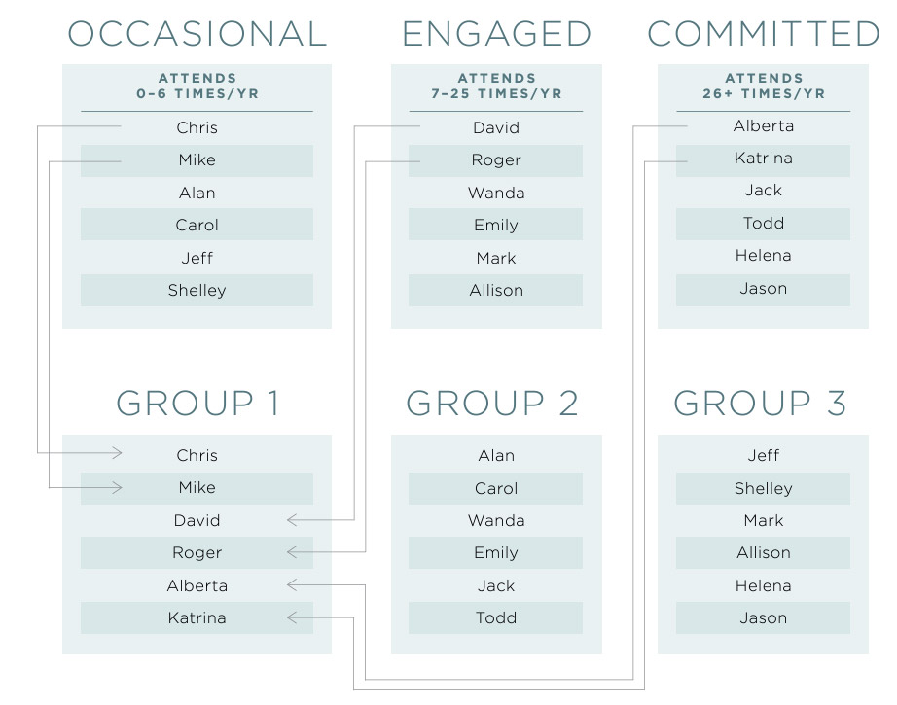

Slide 16
Social Coordinator
Plans meaningful activities and socials for members and prospects
Enlists a team for each function
Sets the date, time, place and activities involved
Invites all members and prospects
Encourages members to bring unsaved/ unchurched friends

Slide 17
Greeter
Arrives 10 minutes early to greet guests
Recruits group members to remain at the door to greet all guests
Welcomes everyone into the classroom
Hands out name tags to members and guests
Introduces guests to group members
Enlists group members to pair up with guests
Works the room, serving as a host for the group

Slide 18
Missions Liaison
Leads the group to become directly involved in mission opportunities
Local: community ministries
National: church planting/establishing
International: by age division; Prestonwood-sponsored
Leads the group to participate in at least four church-associated mission opportunities

Slide 19
Men’s Ministry Liaison
Serves as a liaison between the Men’s Ministry and men in the group
Involves men in approved Men’s Discipleship Classes, Friday Morning Men’s Bible Study, and the Men’s Conference
Develops specific men’s social events for the LifeGroup

Slide 20
Women’s Ministry Liaison
Serves as a liaison between the Women’s Ministry and women in the group
Connects women to approved Women’s Bible Studies, the Women’s Conference, and other women’s events hosted by Prestonwood
Develops specific women’s social events for the LifeGroup

Slide 21
Starting a LifeGroup
Gather a Leadership Team
Gather a Core Group
Start Meeting with your Core Group
Launch Group
Continuing Group Leadership

Slide 22
Adult Ministry Leader Guide

Slide 23
Adult Ministry Divisional Meetings
Adult 1: Atrium
Adult 2: Rooms A101-109
Adult 3: The Commons
Adult 4: The Commons
Adult 5: West Wing
Open: Connection Room
Young Singles: Worship Center Entrance B
Single Adults: Sports & Fitness Center

