Slide 1

From Sitting to Serving

Slide 2

From Sitting to Serving
Life Groups have a purpose…Ephesians 4:12
I GET to serve
“...there is a place for willing people in the church…” [Geiger, Transformational Groups]
Who is in the room tonight?
The Sunday School {Life Group Bible Study} is the church organized to do the work of the great commission [Taylor, The Six Core Values of Sunday School]

Slide 3
From Sitting to Serving – Why Should I Serve?
Jesus modeled service…Mark 10:45
“You should lead a small group because in doing so you will contribute to the kingdom of God. You will grow spiritually. You will help others grow spiritually. You will have fun. You will give yourself chance to form deep, life-changing friendships. You will contribute to others forming deep, life-changing friendships. You will learn new things about God and his Word. You will learn new things about yourself. You will help others learn new things and apply them in ways that compound everything I’ve just mentioned. And you will be obeying God. [O’Neal, Field Guide for Small Group Leaders]
I should use the gifts God has given me
  Romans 12:6-8; 1 Corinthians 12:8, 28-30; Ephesians 4:11

Slide 4

From Sitting to Serving – What Can I Do?
We are constantly raising the bar of leadership in Life Group Bible Studies
There are multiple ways you can serve…
Teaching, directing, prayer, building community, men’s and women’s discipleship, hospitality
www.prestonwood.org/leader
  Resources and tools to help you develop as a leader

Slide 5

From Sitting to Serving – What’s Next?
Start praying
  For conviction, direction, and timing
Connect with your minister
Step out in faith!
The story of the Yates Oil Field…
God has wired you for His mission and you are a critical ‘untapped’ resource for His kingdom!

Slide 6
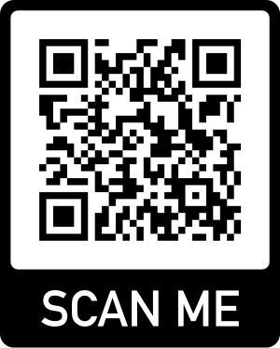

Slide 7


Slide 8
