Slide 1
Benevolence 101
Meeting Financial Needs in Your Life Group
Ron Kelley
Prestonwood Foundation
prestonwoodfoundation.org
rkelley@prestonwood.org
972-820-5439

Slide 2
Prestonwood Foundation prestonwoodfoundation.org
Servant Ministry
Annual Will Drive
Biblical Financial Guidance
Career Transitions
Church Benevolence
Culture Impact Team
Marketplace Ministry Outreach
Legacy Giving
Estate Planning
Family Legacy Fund
Weekly Planned Giving e-Newsletter
Resources (Widows Guide, Life Planning Guide, More Than Money Bible Study)

Slide 3
Introduction
Prestonwood offers one-time financial assistance to church members who qualify.
There is an upward trend over the past three years for Benevolence assistance within the Prestonwood Membership.
Benevolence addresses Financial Hardship – unemployment, sickness, family tragedy, etc.
Issues with affordable housing, increased utility costs and overall inflation have made assistance more expensive.
Local non-profits and government entities have all struggled with funding post-Covid to meet this increased need in our communities.
Another Shift → Urban issues have moved to the Suburbs.
For Prestonwood to assist our members, the Benevolence Budget has increased. To help meet these growing needs, a Benevolence Endowment has also been created.
Designated Gift to the Prestonwood Foundation → Benevolence Endowment
Comment on Life Groups

Slide 4
Benevolence Process
Benevolence Form picked up, completed and returned to Atrium Front Desk at Plano and North Campuses.
Comment on Digital Application.
Completed Form sent to Benevolence Committee.
Committee members have 24 hours to ask questions / offer input.
Follow-up with applicant with questions, discussion via phone, face-to-face meeting, or Zoom

Slide 5
Parameters to Consider
PBC member?
Comment on Attendee status and action taken
Active in the life of the church
Life Group, PSO, Volunteer in some capacity, Record of any Giving, etc.
Unemployment does not dis-qualify someone from receiving assistance if they have an active job search
The circumstances that led to the hardship
Have they requested / received assistance in the past?
Do they have a plan?

Slide 6
What Do We Pay?
Rent / Mortgage
Late Fees?
Utilities (water and electric)
Car Payment
Car Repairs, if it makes sense and reasonable
Car Insurance
Internet / Phone
We require proper documentation (lease, invoices, current bills) as we pay directly to the vendor via check.

Slide 7
How We Go About Our Business
We keep the applicant informed throughout the process. Our tone is always gracious and kindhearted, and we always offer prayer
Even if we cannot provide them financial assistance from Benevolence, we provide a list of other community services
We also connect them with PBC ministries based on their need:
Career Transitions
Biblical Financial Coaching / Classes
Life Recovery
Life Groups
Church Services

Slide 8
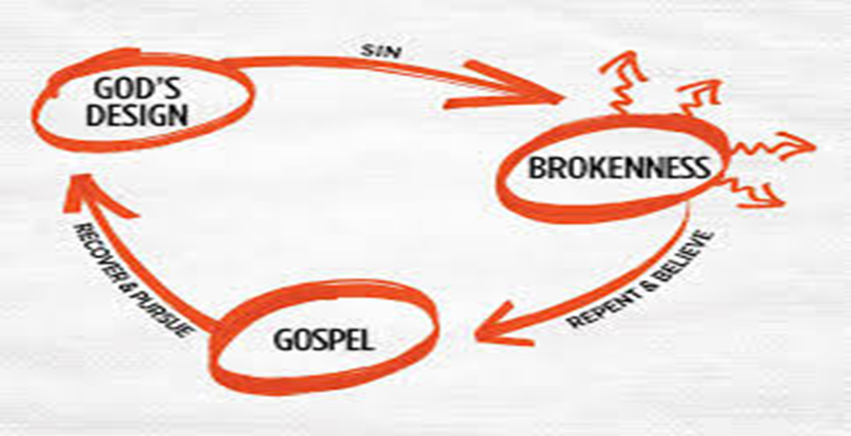
How Do We Handle Homeless People Who Come to the Church
We offer them a meal at Main Street if open
We offer Prayer and the Gospel
We provide list of community resources
Resources most of the time are County based
Homeless Crisis Helpline: 888-411-6802
https://collinhomeless.wixsite.com/cchc for overnight cooling /warming stations
https://www.collincares.org/agency1_list.php

Slide 9
https://prestonwood.org/connect/adults/lifegroup-leader-resources/supporting-your-people-2/

Slide 10
Inflation / Affordable Housing / Utilities
Average Amount Given Per Applicant
2021: $ 1,344
2022: $ 1,612
2023: $ 1,916

Slide 11
Three Year Comparison Prestonwood Dollars Distributed
 | 2021 | 2022 | 2023
Dollars Distributed | $55,428.26 | $79,000.01 | $110,419.25

Slide 12
Some Benevolence Testimonies
Tamar – Husband left her. Has two small children. Found employment but behind on bills since husband has provided no $ assistance. Pending member status. Arranged Baptism and now a Member with children.
Yaneth – Single Mother with sick daughter. Lives paycheck to paycheck. Lost income due to daughter’s illness. No Family Support. Active in Espanol
Lawana – 84 years old. North Campus member. Domestic and Financial Abuse. Divorce. No place to go. Found employment and apartment to live. Assisted with rent and down payment.
Carolyn – Apartment burned down. Car was stolen. Needed help to get back on her feet. Job laid her off due to missing work. Providing downpayment to get into new apartment and turn on utilities.

Slide 13
Quick Summary
Benevolence is provided to:
PBC members
One-Time Assistance - are there exceptions?
If you are an active member in the church, we’re going to work hard to find a solution.
Example: Family Tragedy
If we cannot assist financially, we will provide community resources.
We strongly encourage seeking help to address core issue that caused hardship.
Three Reasons Why God Created Money?

